Slide 1

Combatting Airline Safety Concerns
Presenter Christopher Nosky

Slide 2



Agenda
Passenger Safety
Industry Safety Trend
United Airlines Trend
Our Commitment
Questions

Slide 3




Introduction
With the recent rise in Airline safety incidents a thorough review of United Airlines safety record vs. the Industries safety record was necessary to address customer concerns as well as identify areas we can improve.

Slide 4

Passenger Safety
It is everyone’s business.

Slide 5
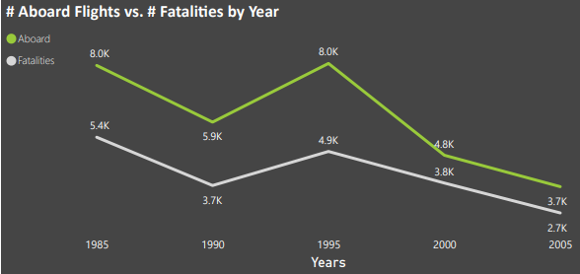
Total Passengers verses Total Fatalities by Year 1985 - 2010
While trends are certainly working in our favor, there is still much work to be done.
Across all airlines the number of fatalities on flights is still a concern. As this chart shows, the trend of fatalities is on the decline.

Slide 6
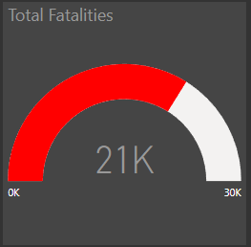
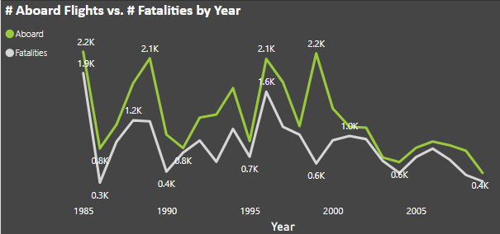
Fatalities by Year
The 25-year trend for the industry has had its ups and downs, a direct result of an “out of sight, out of mind” mentality. We see spikes every few years and it reminds all of us why we must be diligent. We have in the last decade managed to keep the intensity of the spikes down and drive the total number lower.

Slide 7

The way to get started is to quit talking and begin doing.
Walt Disney

Slide 8
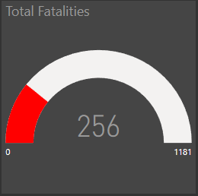
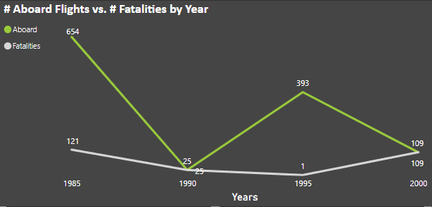
United Airlines
At United, our commitment to safety has yielded positive results.
While not perfect, we do continue to reduce the number of incidents involving our flights.
More important however is that we’ve managed to limit the number of fatalities stemming from those incidents.

Slide 9
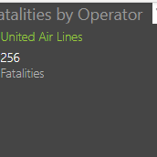
Our Commitment
We will continue to place passenger safety at the forefront of everything we do.
Until this number is at zero, there is always more that can be done.

Slide 10


Thank You
Questions?

